Slide 1
Branching Policies
Alejandro París Gómez

Slide 2

Concept
Branching policies are rules that are established
to maintain control over the project.

Slide 3
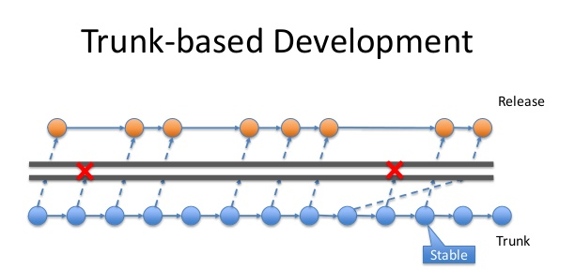
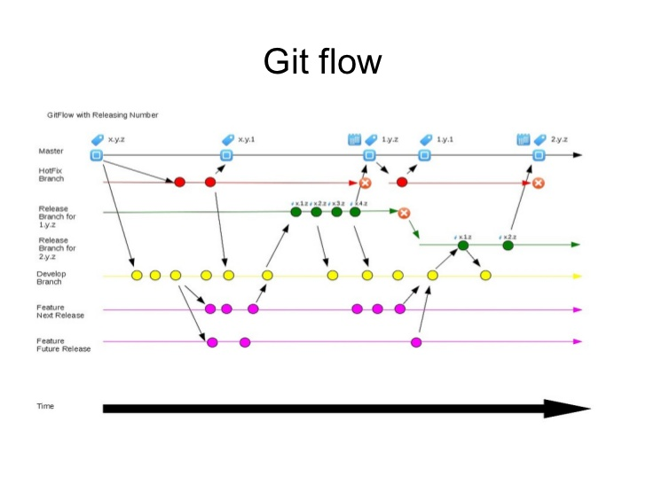
Benefits and Drawbacks
Feature Branching Development

Slide 4
TODO 0: Think about a branch policy for your project
Number of branches and their organization.
Will some branches have a supervisor/owner?
Notes:
Ejercicio para reflexionar sobre que ramas serán realmente necesarias y cuales sólo complicaron el desarrollo
Establecer que reglas basicas van a seguir a parte de la estructura de gitflow y como se van a organizar.

Slide 5
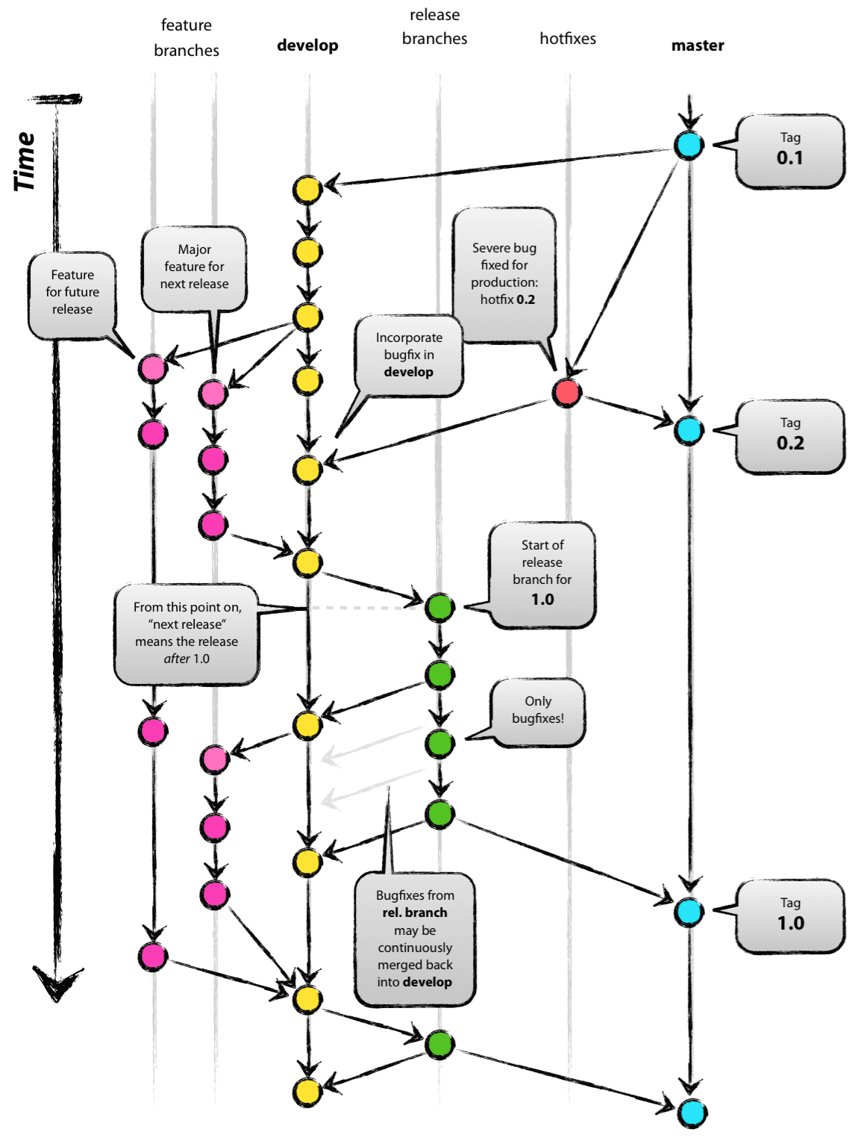
Git Flow

Slide 6
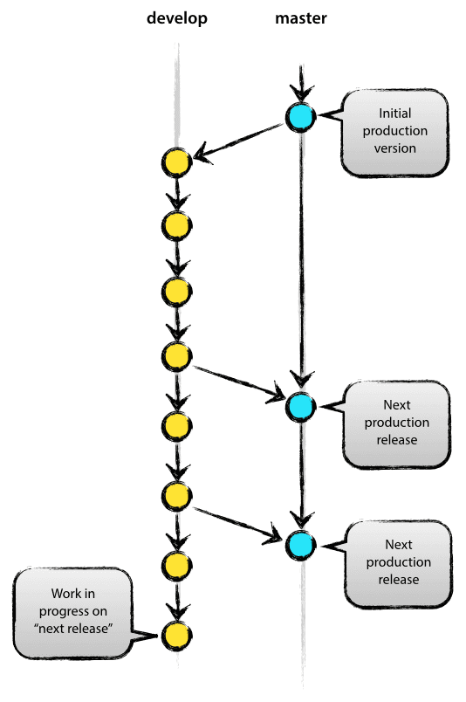
Main Branches
Master: Contains every release of the project. Owner: QA Lead
Develop: Contains the "current" state of the project. Owner: Code Lead

Slide 7
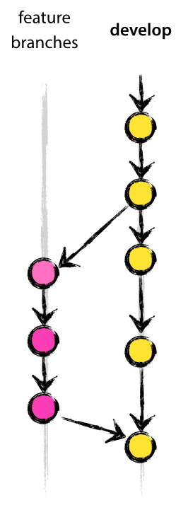
Feature
May branch off from: develop Must merge back into: develop
The feature branches are used to develop specific tasks for each one of them.

Slide 8
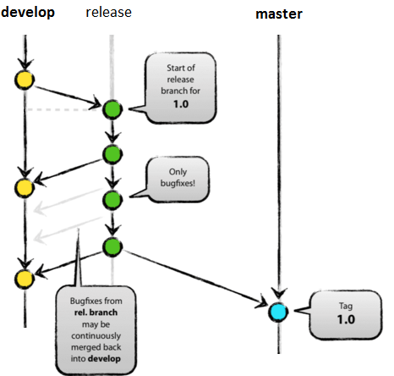
Release
May branch off from: develop Must merge back into: develop and master Owner: QA Lead
Release branches support preparation of a new production release.

Slide 9
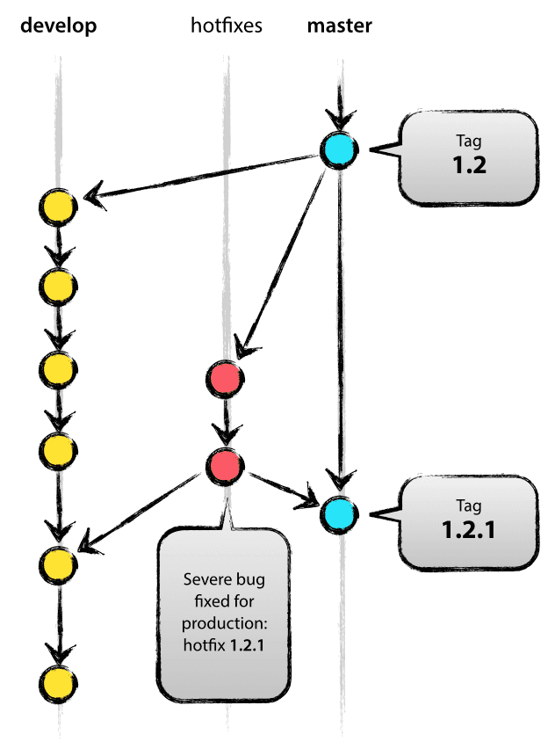
Hotfix
May branch off from: master Must merge back into: develop and master Owner: Code Lead
Critical errors that may arise in the release are fixed in hotfix branch.

Slide 10
TODO 1: Create the Git Flow for your repositories
Remember that developers will be in charge of the main branches.
Create your main branches in git now
Notes:
Ejercicio para acabar de definir las políticas de ramas de cada equipo y que aprovechen y preparen sus ramas principales con los permisos correspondientes

Slide 11
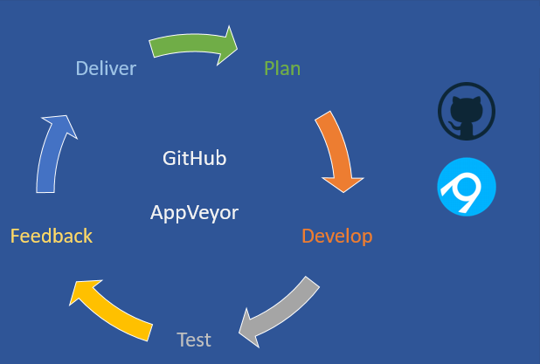
Appveyor
Appveyor will generate a build for each commit that is made in the repository.
We can configure Appveyor to do the builds only when a commit is made in some specific branches.

Slide 12
TODO 2: Make your Appveyor account and connect with your repositorie
Define the branches of which you are going to make builds.
Test it.

Slide 13
Contact
Mail: paris.alejandro1@gmail.com
CITM: alejandropg6

